Slide 1
WEB API 2.0

Slide 2
What is an API?
An application programming interface (API) is a specification intended to be used as an interface by software components to communicate with each other. An APl may include specifications for routines, data structures, object classes, and variables.
Web API has REST Services (HTTP + XML/JSON)
Web APIs allow the combination of multiple services into new applications known as mashups.

Slide 3
Why ASP.NET MVC Web Api?
Web Api
— Defined in HTTP
— Messages in Json/XML
— RESTful
— CRUD operations
— Ready for Cloud

Slide 4
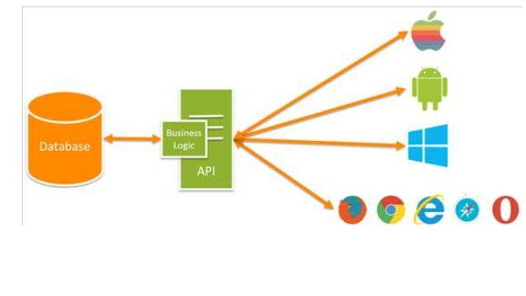

Slide 5
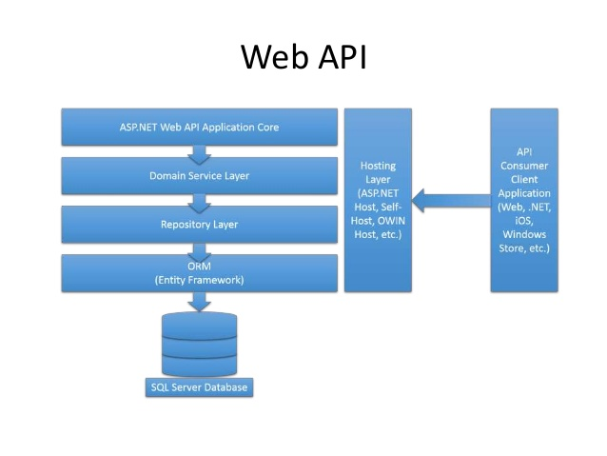

Slide 6
WEB API 2.0 FEATURES
Modern HTTP programming model
Access to strongly typed HTTP object model
HttpClient APl - same programming model
Content negotiation
Client and server work together to determine the right format for data
Provide default support for JSON, XML and Form URL-encoded formats
We can add own formats and change content negotiation strategy

Slide 7
Query composition
Support automatic paging and sorting
Support querying via the OData URL conventions when we return IQueryable<T>
Model binding and validation
Combine HTTP data in POCO models
Data validation via attributes
Supports the same model binding and
validation infrastructure as ASP.NET MVC
Routes (mapping between URIs and code)
Full set of routing capabilities supported within ASP.NET (MVC)
Filters
Easily decorates Web API with additional validation (authorization, CORS, etc.)
Testability
loC and dependency injection support
Flexible hosting (IIS, Azure, self-hosting)

Slide 8
WEB API vs WEB API 2
Attribute routing
OData improvements: $select, sexpand, $batch, $value and improved extensibility
Request batching
Portable ASP.NET Web API Client
Improved testability
CORS (Cross-origin resource sharing)
Authentication filters
OWIN support and integration (owin.org)

Slide 9
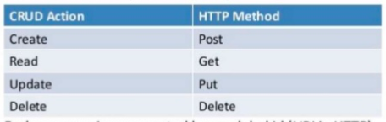
Rest - Representational State Transfer
RESTis a style of software architecture for distributed systems such as the WWW, where, virtually in all cases, the HTTP protocol is used.
Uses CRUD actions (HTTP methods)
Each resource is represented by an global id (URI in HTTP)
The resources are conceptually separate from the representations that are returned to the client (JSON/XML)
In many ways, the World Wide Web itself, based on HTTP, can be viewed as a REST-based architecture.
Despite being simple, REST is fully-featured; there's basically nothing you can do in Web Services that can't be done with a RESTful architecture!

Slide 10
Token Based Authentication
It is the process when a Resource Owner or
Client is granted a token by providing their
credentials to an Authorization Server.
The obtained access token can then be
presented to a Resource Server to access a
Protected resource

Slide 11
Authentication Filter
An Authorization filter inherits from the AuthorizationFilterAttribute class and typically overrides the OnAuthorization() method which should handle the authorization tasks. The filter should do nothing to allow a request through if authorization is valid, throw a UnauthorizedException() if it fails to validate a user, or return a new custom HttpResponseMessage.

Slide 12
HTTP VERBS
The four main HTTP methods are mapped to CRUD operations:
GET retrieves the representation of the resource at a specified URI. GET should have no side effects on the server.
PUT updates a resource at a specified URI (idempotent).
POST creates a new resource. The server assigns the URI for the new object and returns this URI as part of the response message.
DELETE deletes a resource at a specified URI (idempotent).
PATCH type should be used to update any partial resources. This verb should be used only to update the existing entry with partial data in database or other source.

Slide 13
HTTP GET
This verb should be used only to get information or data from database or other source. The code will look like the given code.
/// <summary>
/// Get Data from db
/// </summary>
/// <returns></returns>
[HttpGet]
[SwaggerOperation(Tags = new[] { "xyz" })]
[Route("GetData")]
public IHttpActionResult GetData()
{
var list = _provider.GetData();
if (list == null)
{
return NotFound();
}
return Ok(list);
}

Slide 14
HTTP POST
This verb should be used only to post or create new entry with information or data to database or other source. Code will look like the given below.
[HttpPost]
[SwaggerOperation(Tags = new[] { "Dictionary" })]
public IHttpActionResult SaveData(CustomerInfo obj)
{
ResponseWrapper responseObj = new ResponseWrapper();
try {
var _result = _provider.SaveData(obj);
if (_result != null){
responseObj.status = "success";
responseObj.data = new { message = _result };
} else {
responseObj.status = "warning";
responseObj.data = new { message = "Operation Failed." };
} }
catch (Exception ex)
{ responseObj.status = "error";
responseObj.data = new { message = ex.Message }; }
return Ok(responseObj);
}

Slide 15
HTTP PUT
This verb should be used only to update the existing entry with information or data to database or other source. The code will look like the given code.
[HttpPut]
[SwaggerOperation(Tags = new[] { "Dictionary" })] [Route("UpdateData")]
public IHttpActionResult UpdateData(CustomerInfo obj)
{
ResponseWrapper responseObj = new ResponseWrapper();
try {
var _result = _provider.UpdateData(obj);
if (_result != null) {
responseObj.status = "success";
responseObj.data = new { message = _result };
} else{
responseObj.status = "warning";
responseObj.data = new { message = "Operation Failed." };
}}
catch (Exception ex) {
responseObj.status = "error";
responseObj.data = new { message = ex.Message };
}
return Ok(responseObj);
}

Slide 16
HTTP DELETE
[HttpPut]
[SwaggerOperation(Tags = new[] { "Client Dictionary" })] [Route("DeleteData/{Id}")]
public IHttpActionResult DeleteData(int Id)
{
ResponseWrapper responseObj = new ResponseWrapper();
try
{
var _result = _provider.DeleteData(Id);
if (_result != null) {
responseObj.status = "success";
responseObj.data = new { message = _result };
} else {
responseObj.status = "warning";
responseObj.data = new { message = "Operation Failed." };
}}
catch (Exception ex){
responseObj.status = "error";
responseObj.data = new { message = ex.Message };
}
return Ok(responseObj);
}

Slide 17
HTTP PATCH
[HttpPatch]
[SwaggerOperation(Tags = new[] { "Dictionary" })]
[Route("UpdateData/{Id}")]
public IHttpActionResult UpdateData(int Id)
{
ResponseWrapper responseObj = new ResponseWrapper();
try
{
var _result = _provider.UpdateData(Id);
if (_result != null)
{
responseObj.status = "success";
responseObj.data = new { message = _result };
}
else
{
responseObj.status = "warning";
responseObj.data = new { message = "Operation Failed." };
}
}
catch (Exception ex)
{
responseObj.status = "error";
responseObj.data = new { message = ex.Message };
}
return Ok(responseObj);
}

Slide 18
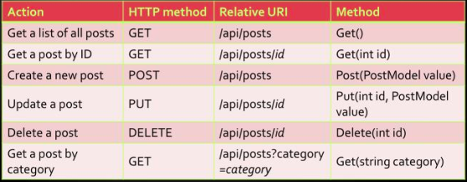

Slide 19
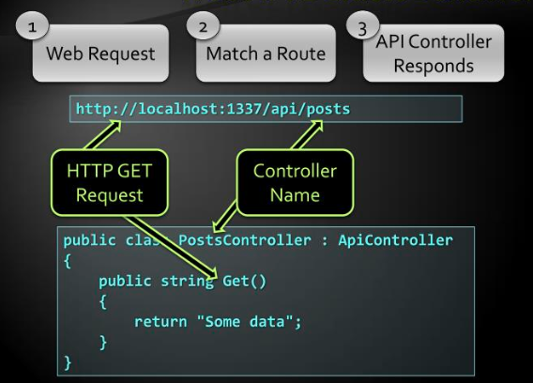
WEB API Default Behaviour

Slide 20
Web API routing and actions
MapHttpRoute in ASP.NET Web Api 2
routes.MapHttpRoute("DefaultApi","api/{controller}/{id}", new {id =RouteParameter.Optional });
MapHttpRoute really different from defaultrouting in ASP.NET MVC
routes.MapRoute("Default","{controller}/{action}/{id}", new {controller = "Home", action = "Index", id =UrlParameter.Optional });

Slide 21
Status Codes
By default when everything is OK, we return HTTP status code 200
Sometimes we need to return error
public HttpResponseMessage Get(int id)
{
if (dataExists)
{
return Request.CreateResponse(
HttpStatusCode.OK, data);
}
else
{
return Request.CreateErrorResponse(HttpStatusCode.NotFound, "Item not found!");
}
}

Slide 22
Return Status
200 0K
201 Created
400 Bad Request
401 Unauthorized
404 Not Found
409 Conflict
500 Internal Server Error
501 Not Implemented

Slide 23
HTTP Client Model
HttpClient is a modern HTTP client for .NET
Flexible and extensible API for accessing HTTP
Has the same programming model as the ASP.NET Web API server side
HttpRequestMessage / HttpResponseMessage
var client = new HttpClient {
BaseAddress = new Uri("http://localhost:28670/") };
client.DefaultRequestHeaders.Accept.Add(new
MediaTypeWithQualityHeaderValue("application/json"));
HttpResponseMessage response =
client.GetAsync("api/posts”).Result;
if (response.IsSuccessStatusCode)
{
var products = response.Content
-ReadAsAsync<IEnumerable<Post>>() . Result;
foreach (var p in products)
{
Console.WriteLine("{0,4} {1,-20} {2}",
p.Id, p.Title, p.CreatedOn);
}
}
else
Console.WriteLine("{0} ({1})",
(int)response.StatusCode, response.ReasonPhrase);

Slide 24
Thank you

